Slide 1
b1001 Single Cycle CPU
ENGR xD52
Eric VanWyk
Fall 2012

Slide 2
Today
Intro to Memory and Assembly
The Execution of an Instruction
Intro to Simple CPU Design
Assign Homework & Lab

Slide 3
Context
We now have almost all of the building blocks of a computer!
Nearing completion of our first “spiral”
We are still missing Memory and Assembly
Moving forward we will dive deeper into each of these building blocks to expand capabilities

Slide 4
Context
You will learn the dark arts of box opacity
Practice thinking hierarchically

Slide 5
Assembly
The human readable version of the instructions the machine executes
Closely related to “Op Codes” and Instructions
We will go over this in detail on Monday

Slide 6
Memories
We will devote several lectures entirely to memory
Your new lab is about one type of memory
I will treat it as an opaque black box for this lecture, and open it in much more detail later

Slide 7
Memory
Can be read like a Look Up Table
“Address” instead of “Select”
Sometimes you can write to it
Defined by width, depth, access time, number and type of ports

Slide 8
Datapath & Control
Readings 5.1-5.4
Datapath: System for performing operations on data, plus memory access.
Control: Control the datapath in response to instructions.
Computer
Processor
Memory
Devices
Control
Input
Datapath
Output

Slide 9
Execution Overview
Instruction
Fetch
Fetch instruction from memory
Decode instruction into actions/controls
Fetch/Decode operands
Compute result value or status
Push result(s) to storage
Determine next instruction
Instruction
Decode
Operand
Fetch
Execute
Result
Store
Next
Instruction

Slide 10
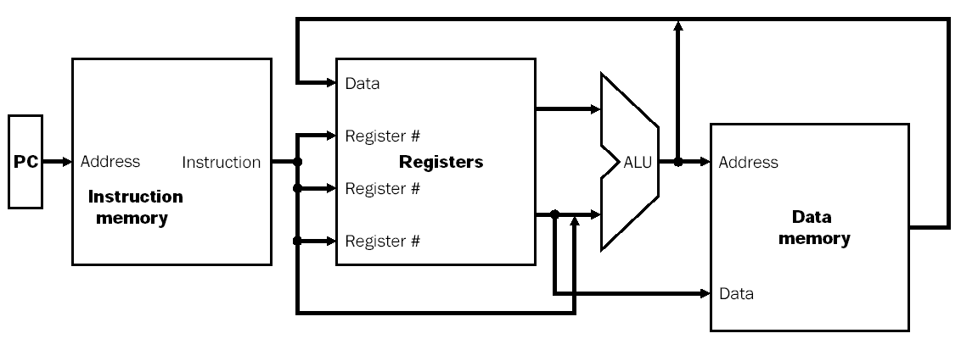
Processor Overview
Overall Dataflow
PC fetches instructions
Instructions select operand registers, ALU immediate values
ALU computes values
Load/Store addresses computed in ALU
Result goes to register file or Data memory

Slide 11
Program/Instruction Memory
Large, single ported read-only memory
For today
Stores the program the processor executes
Instructions are 4 bytes wide
For today

Slide 12
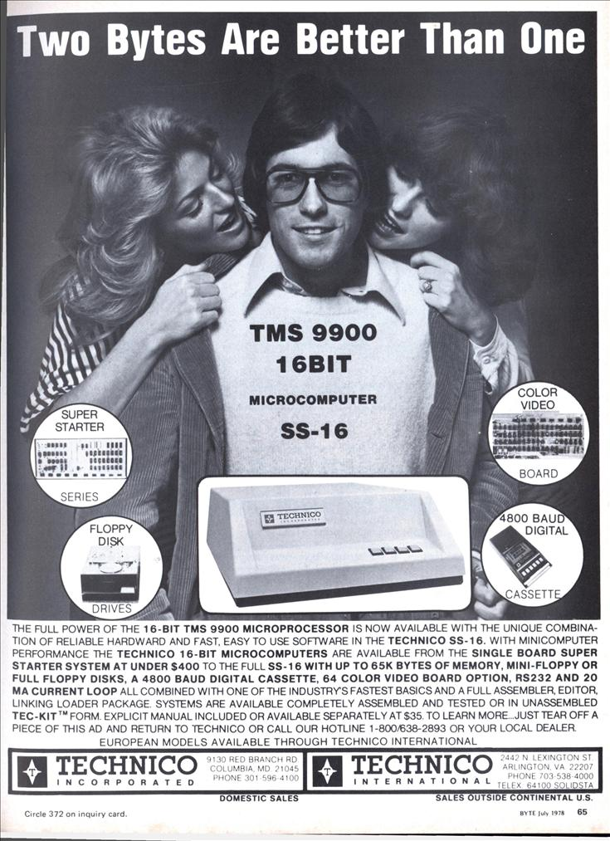
Why 4?
Today we are assuming 4 byte instructions
Why? This is hilarious and I needed an excuse to show it to you.

Slide 13
Fetch Instruction
Fetch instruction from program memory
Use a special register to keep track of where we are in the program
“Program Counter” or “PC”
To start, assume program flow is always linear
Spoiler Alert: It isn’t

Slide 14
Fetch Instruction
Instruction = Mem[PC]; // Fetch Instruction
PC = PC + 4; // Increment PC
Address
Instruction
Memory
PC
Adder
“4”
Instr[31:0]

Slide 15
Instruction Decode
We have an Instruction!
Decode it in to control signals
All the blue “hair” in the diagrams
Some signals are just pulled straight out
Just “wires”
e.g. Register Addresses
Most must be Decoded first

Slide 16
Fetch/Decode
We’ll draw these two units together as the Instruction Fetch / Decode Unit
Instruction
Fetch
Unit
Instruction[31:0]
[25:21]
[20:16]
[15:11]
Rs
Rt
Rd
“Blue Hair”

Slide 17
Register File
Very small, very fast multi-ported memory
Small depth, large area
Each cycle reads 2 words, optionally writes 1
This is the “scratch space” for the processor
This is your lab

Slide 18
Fetch Operands
Get Operand Addresses
Pull from Register File
Rd Rs Rt
ALUcntrl
Aw Aa Ab Da
Dw Db
Register
WrEn File
RegWr

Slide 19
Execute
ALU controls from Instruction Fetch/Decode
Perform actual computation in ALU
Rd Rs Rt
ALUcntrl
Aw Aa Ab Da
Dw Db
Register
WrEn File
Result
RegWr

Slide 20
Execute
ALU controls from Instruction Fetch/Decode
Perform actual computation in ALU
Rd Rs Rt
ALUcntrl
Aw Aa Ab Da
Dw Db
Register
WrEn File
RegWr

Slide 21
Store Results
Most Instructions store the result back to the register file
Others have other effects
Instructions[31:0]
Instruction
Fetch
Unit
[25:21]
[20:16]
[15:11]
Rs
Rt
Rd
Rd Rs Rt
ALUcntrl
Aw Aa Ab Da
Dw Db
Register
WrEn File
RegWr

Slide 22
Next Instruction
Full Circle!
Usually just increment’n’go
Some instructions change the PC
Branch if some condition is true
When you hear “if”, what do you think of?
Jump regardless of conditions
Jumpst Do It

Slide 23
My First CPU
Lets design a very simple CPU
Ultimate Reduced Instruction Set Computer
Only one Instruction
Still Turing Complete!
Subtract Branch if Negative

Slide 24
My First CPU
The One True Instruction:
R = A – B
If R is negative, jump to specified location
If R is positive, increment PC by 4
Draw high level schematic
ALU, PC, Register File, Instruction Memory, Instruction Decoder, etc
What do you have to add to Branch?
What command signals are necessary?
Hint: Use Very Wide Instructions to make it easier
Try trimming the width down using decoding for bonus

Slide 25
Lets Talk Homework
Due Monday, <1 hour
You have options
It is intentionally vague

Slide 26
Lets Talk Labs
It is all about the process
Please do not make this an ugly competition
Cleverness and Realism!

Slide 27
Using Constants (Immediates)
Sometimes we want to use a constant as an operand instead of a Register.
How do you encode a 32 bit constant AND control signals into a 32 bit instruction?
Side Note: The Cortex has interesting options
any constant produced by shifting an 8-bit value
any constant of the form 0x00XY00XY
any constant of the form 0xXY00XY00
any constant of the form 0xXYXYXYXY

Slide 28
Using Constants (Immediates)
Reg[rt] = Reg[rs] + SignExtend(imm);
Instructions[31:0]
Instruction
Fetch
Unit
[25:21]
[20:16]
[15:11]
[15:0]
Rs
Rt
Rd
Imm16
ALUcntrl
Aw Aa Ab Da
Dw Db
Register
WrEn File
RegWr
SignExtnd

Slide 29
Using Constants (Immediates)
Instructions[31:0]
Instruction
Fetch
Unit
Rd
Rt
[15:0]
[25:21]
[20:16]
[15:11]
RegDst
Rs
Rt
ALUcntrl
Rs
Rt
Rd
Imm16
Aw Aa Ab Da
Dw Db
Register
WrEn File
RegWr
SignExtnd
imm16
ALUSrc

Slide 30
Branching
Use Constants as Offsets

Slide 31
Instruction Fetch w/ Branch
if (Cond)
PC = PC + 4 + SignExtend(imm)*4;
else
PC = PC + 4;
Addr[31:2]
Addr[1:0]
Instruction
Memory
“00”
“1”
PC
Cin
Adder
“0”
SignExtnd
0 1
Instr[31:0]
imm16
Branch
Cond

Slide 32
Data Memory
Big Giant Slow Memory
Gigabytes!
Read and Write, but only single port
Pulling from Data Memory to Register
Load
Push from Register to Data Memory
Store

Slide 33
Datapath + Load
Instructions[31:0]
Instruction
Fetch
Unit
Addr = Reg[rs] + SignExtend(imm);
Reg[rt] = Mem[Addr];
[25:21]
[20:16]
[15:11]
[15:0]
Rd
Rt
Rs
Rt
Rd
Imm16
RegDst
Rs
Rt
ALUcntrl
MemWr
Aw Aa Ab Da
Dw Db
Register
WrEn File
RegWr
WrEn Addr
Din Dout
Data
Memory
SignExtnd
imm16
ALUSrc

Slide 34
Datapath + Store
Instructions[31:0]
Addr = Reg[rs] + SignExtend(imm);
Mem[Addr] = Reg[rt];
Note: State of RegWr, MemToReg?
Instruction
Fetch
Unit
[25:21]
[20:16]
[15:11]
[15:0]
Rd
Rt
Rs
Rt
Rd
Imm16
RegDst
Rs
Rt
ALUcntrl
MemWr
MemToReg
Aw Aa Ab Da
Dw Db
Register
WrEn File
RegWr
WrEn Addr
Din Dout
Data
Memory
SignExtnd
imm16
ALUSrc

Slide 35
Complete Datapath
Instructions[31:0]
Branch
Instruction
Fetch
Unit
Rd
Rt
Jump
[15:0]
[25:21]
[20:16]
[15:11]
RegDst
Rs
Rt
ALUcntrl
Rs
Rt
Rd
Imm16
Zero
MemWr
MemToReg
Aw Aa Ab Da
Dw Db
Register
WrEn File
RegWr
WrEn Addr
Din Dout
Data
Memory
SignExtnd
imm16
ALUSrc

Slide 36
With the remaining time
Modify the Fetch Unit
So it doesn’t waste bits (4 byte alignment…)
So it can execute {Absolute/Relative} {Jump/Branches}
Document all the control signal states for:
X= Y + Z
X = Y – Constant
Branch back 12 instructions if X == Y
Branch forward 1 instruction if X < Y
Begin Work on Lab/HW

